Slide 1

Quantifying Behavioral Changes Included by Mobile Application Usage Using Passive Sensing and Machine Learning
Prof. Ghulam Sarwar
Research Methodology(Spring 2024)
Tamang Anil(2417132)
Thing Suman(2417121)
Thakur Subodh(2417134)
Mahato Roshan Kumar(2417104)
Hitan Nirajan( 2417140 )

Slide 2

Introduction
• Analyze behavior via mobile usage
• Uses passive sensing data
• Applies machine learning for insights

Slide 3
Problem Statement
• Mobile usage impacts behavior
• Current methods rely on self-reporting
• Need automated real-time analysis system

Slide 4
Objectives
• Collect user data automatically
• Analyze behavioral patterns
• Provide insights and recommendations

Slide 5
Methodology
1. Data Collection
2. Data Preprocessing
3. ML Model Application
4. Behavior Analysis

Slide 6
System Architecture
• Data Collection Layer
• Processing Layer
• ML Layer
• Presentation Layer

Slide 7
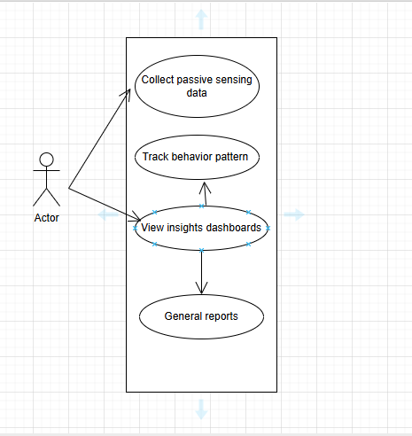
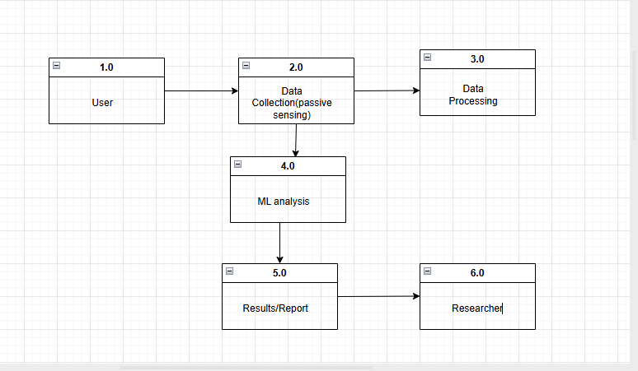
Design Models
1.Use Case Diagram
Data flow Diagram(DFD)

Slide 8
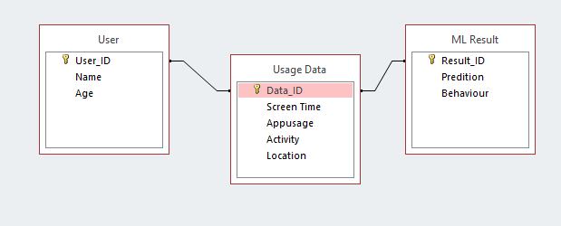
3.Er Diagram

Slide 9
Features
• App usage tracking
• Sensor data collection
• Behavior classification
• Dashboard & reports

Slide 10
Technologies Used
• Python
• TensorFlow / Scikit-learn
• Google Fit API
• Firebase
• Pandas & NumPy

Slide 11

Testing
• Unit Testing
• Integration Testing
• Functional Testing
• System Testing
• Automated Testing

Slide 12
Results
• Detects behavior patterns
• Provides insights
• Improves accuracy over traditional methods

Slide 13
Conclusion
• Effective system for behavior analysis
• Combines sensing + ML
• Useful for real-world applications

Slide 14
Future Work
• Improve ML accuracy
• Real-time analysis
• Better UI dashboard
• Smart recommendations

